Slide 1
Sorting
Array and String Methods

Slide 2
Complexity: Big O notation
The Big O is basically a way to describe an algorithms “abstract” performance in operation as the operation’s inputs grow in size toward infinity.

Slide 3
Bubble Sort
Compare each pair of adjacent elements from the beginning of an array and, if they are in reversed order, swap them.
If at least one swap has been done, repeat step A.

Slide 4
Bubble Sort

Slide 5
Bubble Sort Complexity
Worst-case performance - O(n²) Best-case performance - O(n) Average performance - O(n²)

Slide 6
MergeSort
If the list is of length 0 or 1, then it is already sorted. Otherwise:
Divide the unsorted list into two sublists of about half the size.
Sort each sublist recursively by re-applying merge sort.
Merge the two sublists back into one sorted list.

Slide 7
MergeSort

Slide 8
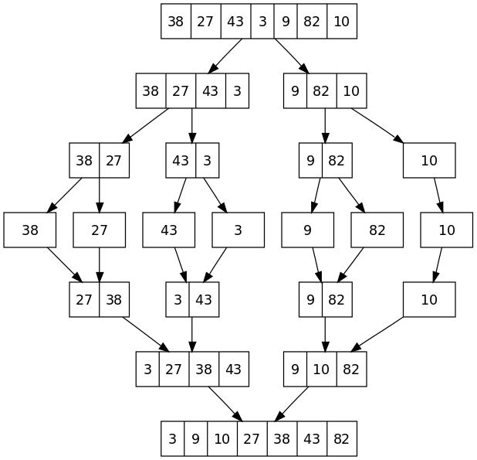
MergeSort - Sorting Tree

Slide 9
MergeSort Complexity
Worst-case performance - O(n log n)
Best-case performance - O(n log n) typical, O(n) natural variant
Average performance - O(n log n)

Slide 10
https://www.toptal.com/developers/sorting-algorithms
https://www.cs.usfca.edu/~galles/visualization/ComparisonSort.html
http://www.stoimen.com/blog/2010/07/09/friday-algorithms-javascript-bubble-sort/
http://codingmiles.com/sorting-algorithms-bubble-sort-using-javascript/
http://www.stoimen.com/blog/2010/07/02/friday-algorithms-javascript-merge-sort/

